Slide 1
AAA HONOR ROLL CEREMONY
[date]
[location]
Notes:
1

Slide 2
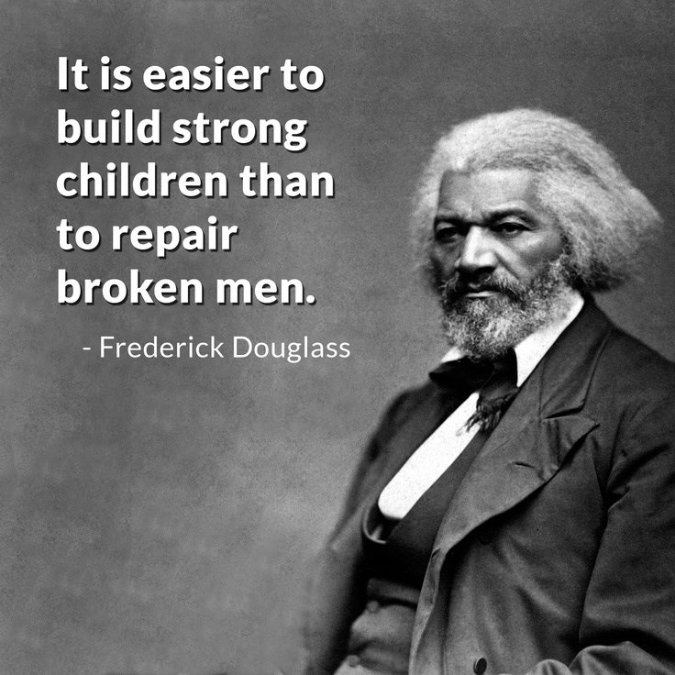
Astro Expectations
Notes:
Astro Expectations

Slide 3
AAA Honor Roll
Academics
Attendance
Attitude/Behavior
Notes:
Triple A

Slide 4
AAA Honor Roll
Academics:
No pattern of poor performance. Three or more As.
Notes:
academics

Slide 5
AAA Honor Roll
Attendance:
Regular daily attendance. No pattern of absences. 97% attendance or better.
Notes:
attendance

Slide 6
AAA Honor Roll
Attitude/Behavior:
Good attitude and behavior. No pattern of misbehavior in class or on campus. No Out of School Suspensions.
Notes:
attitude/behavior

Slide 7
AAA Honor Roll Award Presentations
Ninth Graders
Tenth Graders
Eleventh Graders
Twelfth Graders
Notes:
Award Presentations

Slide 8
Notes:
Leadership matters – the power of pro-social peer pressure

